Slide 1
IBSA VET Capability Framework

Slide 2
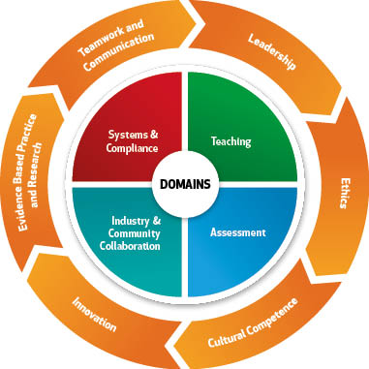
Capability Frameworks
Capability (or ability) frameworks describe the skills and behaviours that people will demonstrate if they are doing high quality work. These frameworks provide an over-arching list of the skills required in particular work settings or contexts. They are broad descriptions, against which specific skills can be mapped.
Typically they cover a range of job roles and/or work contexts.
IBSA has undertaken this work to develop a framework to assist in
  professional development – RTOs need to show that they are continually developing the skills of their staff in both their VET and vocational skills
  determining what gaps currently exist in the TAE10 training package

Slide 3
IBSA VET Capability
Framework process
The framework was developed by a process that involved
  Setting up a national project reference group to guide development
  Engaging Precision Consultancy to
    research existing frameworks that covered VET practitioners at state, territory, enterprise or broader levels
    write and circulate a discussion paper, produce an initial draft
    consult nationally and through the IBSA website and workshops across Australia
    revise and produce a second draft for further consultation
    work with IBSA’s national project reference group to finalise the framework
    map the final draft framework against the TAE10 training package to identify areas where there appears to be good coverage, as well as gaps.

Slide 4
IBSA VET Capability
Framework
The final framework consists of:
  4 domains – areas of work, or ‘what people do’, each broken down into capabilities
  6 skill areas – ways of working, or skills to be applied in order to do the work well
  3 practitioner levels – to show development of the capability or skill
  For each domain (area of work) a practitioner can identify their own capabilities. Most will have a matrix of capabilities, from different levels in the framework. Some will specialize in one or more domains.
The 4 domains and 6 skill areas are shown on the following diagram and then each of the domains and skill areas are broken down into capabilities at each of three levels in the following pages.

Slide 6
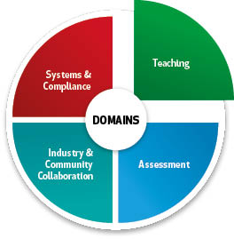
First Level Practitioner
Learning theories | Design | Facilitation | Evaluation
Demonstrates awareness of educational theories Determines applicability of theories to the learning needs of individuals and groups | Contributes to development of resources and programs that generate authentic learning experiences Contributes to the design of flexible learning strategies | Uses strategies and skills to ensure learner engagement and achievement of learning outcomes Creates supportive learner inter-relationships Uses a range of technologies effectively | Contributes to program evaluation Seeks regular feedback to evaluate own performance and plan for improvements

Slide 7
Second Level Practitioner
Learning theories | Design | Facilitation | Evaluation
Investigates a range of learning theories to expand and improve teaching repertoire for a range of learners | Designs learning programs that meet industry expectations and provide meaningful learning experiences | Develops and implements models for learner connectedness Demonstrates a range of facilitation strategies to respond to diverse learner groups and contexts Guides others in the use of alternative delivery methods | Evaluates program outcomes using established tools and techniques Modifies program design in response to evaluation outcomes

Slide 8
Third Level Practitioner
Learning theories | Design | Facilitation | Evaluation
Reviews theoretical frameworks about learning and teaching in VET Applies and models the use of theories in VET teaching practice | Provides leadership and recognised expertise in learning design, across varying contexts and a range of delivery methods | Applies and models a broad range of facilitation techniques Leads others to develop their facilitation approaches across a range of delivery contexts | Negotiates with clients and stakeholders to identify measures of success and evaluation strategy Develops and implements tools and techniques to evaluate program outcomes Reports on evaluation outcomes and recommends system improvements

Slide 9
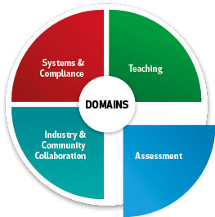
First Level Practitioner
Assessment theories | Products | Processes | Validation
Demonstrates understanding of the principles of assessment and the rules of evidence | Contributes to the development of assessment tools, or modifies existing ones, to suit client needs and specified context | Employs a range of methods to ensure validity and reliability in assessment decisions | Participates in assessment validation processes

Slide 10
Second Level Practitioner
Assessment theories | Products | Processes | Validation
Uses contemporary assessment research and theory to inform and expand practice | Designs, develops and evaluates assessment tools for purposes including RPL and assessment of training outcomes Uses a variety of technologies to develop and implement the tools | Adapts assessment approaches as required for different contexts and candidates Reviews assessment processes and identifies improvements Provides assessment feedback to support continued learning | Actively contributes to assessment validation processes Uses validation outcomes to improve practice

Slide 11
Third Level Practitioner
Assessment theories | Products | Processes | Validation
Leads others to interpret and apply relevant theory to improve assessment practice Undertakes research to inform assessment practice | Designs and implements continuous improvement strategies to ensure assessment tools meet industry and system requirements | Consults with stakeholders to design holistic assessment approaches Leads quality assessment practices Explores opportunities for innovation and improvements in assessment processes | Coordinates industry validation Critically evaluates validation outcomes and implements improvements to assessment strategies

Slide 12
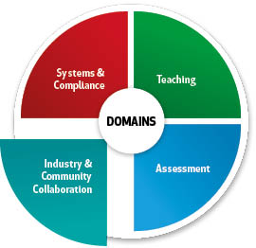
First Level Practitioner
Engagement | Networks | Vocational competence | Workforce development
Liaises with enterprises to ensure teaching and assessment reflects current industry practices | Participates in enterprise networks to enhance own knowledge and skills | Maintains vocational competence relevant to own subject area and works with others to maintain that competence Uses a range of methods to keep up-to-date with industry changes | Contextualises program content and adapts teaching practices to suit specified enterprise needs

Slide 13
Second Level Practitioner
Engagement | Networks | Vocational competence | Workforce development
Builds relationships with enterprises and stakeholders to ensure learning programs, and related assessment, meet the client’s needs | Engages in networks to support sharing of vocational, and learning and assessment, knowledge and skills | Implements approaches to build vocational competence leading to industry credibility | Designs training and other solutions to meet identified workforce development needs

Slide 14
Third Level Practitioner
Engagement | Networks | Vocational competence | Workforce development
Negotiates with industry bodies and stakeholders to ensure that learning programs meet or exceed expectations and that teaching and assessment practices reflect current industry trends | Demonstrates leadership in professional networks and provides advice and guidance about industry developments and changes | Develops and implements approaches to build team vocational competence | Work with enterprises to design learning and development strategies that address strategic direction

Slide 15
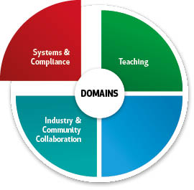
First Level Practitioner
System standards | System stakeholders | Products | Processes
Understands National VET Quality standards and relevant legislation and ensures compliance in own work practices | Develops own knowledge of key stakeholders such as state training authorities, industry skills councils, VET regulators and licensing bodies | Uses current training packages and accredited courses, and supporting tools and resources, to support training and assessment practices | Ensures work practices comply with organisational policies and procedures Maintains accurate and up-to-date records

Slide 16
Second Level Practitioner
System standards | System stakeholders | Products | Processes
Develops approaches to meet compliance requirements and continually improve practice | Monitors activities of VET system stakeholders and uses this knowledge in program design | Contextualises training packages and accredited courses to source and select best products to meet learner needs | Supports policy development and generates ideas for improvements

Slide 17
Third Level Practitioner
System standards | System stakeholders | Products | Processes
Ensures team compliance with National VET Quality standards, and relevant legislation and regulations | Builds sustainable relationships with key stakeholders to improve teaching and assessment practice and build practitioner capability | Provides leadership about training packages and accredited courses, and guides implementation | Reviews and creates policies to guide practice and ensure compliance Ensures team members keep up-to-date records of learner progress and outcomes

Slide 18
First Level Practitioner
Evidence based practice and research | Leadership | Ethics | Cultural competence | Innovation | Teamwork and Communication
Accesses and utilises information and research sources about VET practice and the VET sector as appropriate to teaching level and industry area | Identifies own learning needs and obtains support for professional development | Demonstrates ethical behaviour and regard for confidentiality | Interacts effectively with learners from a variety of cultures Respects and values difference Identifies LLN issues and seeks advice where required to meet learner needs | Contributes ideas to enhance and improve work practices | Adapts communication style to suit audience and context Builds constructive relationships with colleagues and generates ideas for improvements

Slide 19
Second Level Practitioner
Evidence based practice and research | Leadership | Ethics | Cultural competence | Innovation | Teamwork and Communication
Seeks out and critically analyses information and research sources about VET practice and the VET sector Undertakes role appropriate research into own practice | Shares knowledge and experience with team Demonstrates self awareness Provides a positive role model for learners | Supports colleagues in ethical decision-making Respects confidences | Demonstrates awareness of cultural differences and develops strategies to ensure culturally appropriate teaching methods | Generates ideas to provide new and creative ways of working | Seeks professional development opportunities and assists team to identify and address their learning needs

Slide 20
Third Level Practitioner
Evidence based practice and research | Leadership | Ethics | Cultural competence | Innovation | Teamwork and Communication
Identifies issues that need further investigation, and works with others to carry out research beyond own immediate environment | Focuses on achieving priorities and team goals Fosters structured approaches, including reflective practice, to develop team members’ skills | Inspires trust and confidence Demonstrates values, attitudes and behaviours that command respect of colleagues and with learners | Models cross cultural understanding and encourages cultural competence in teaching team | Encourages staff to generate and share new and different approaches Advocates for change | Mentors team to foster learner engagement, retention and success Communicates persuasive messages to a range of audiences

